Slide 1
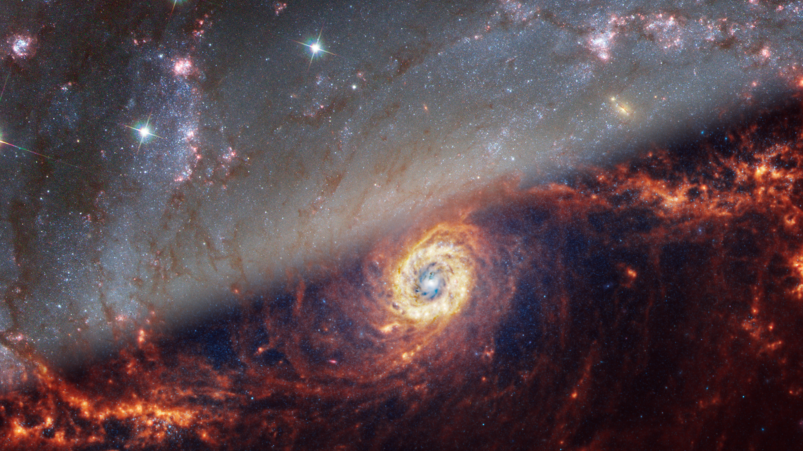
Modeling Spectral Emissions for characterizing real data
Youssef El Gharably – Summer Hackman Research 2024
Professor Trainor
NGC1672 – JWST/Hubble

Slide 2
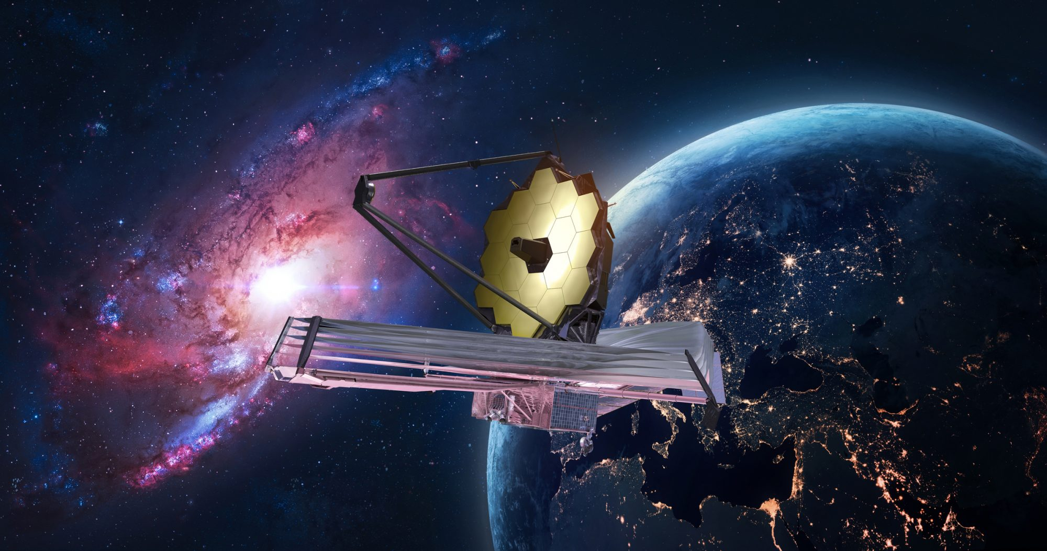
My colleagues have gotten a chance to tell you about the CECILIA survey and show you a bunch of pretty JWST pictures
I live here :D

Slide 3
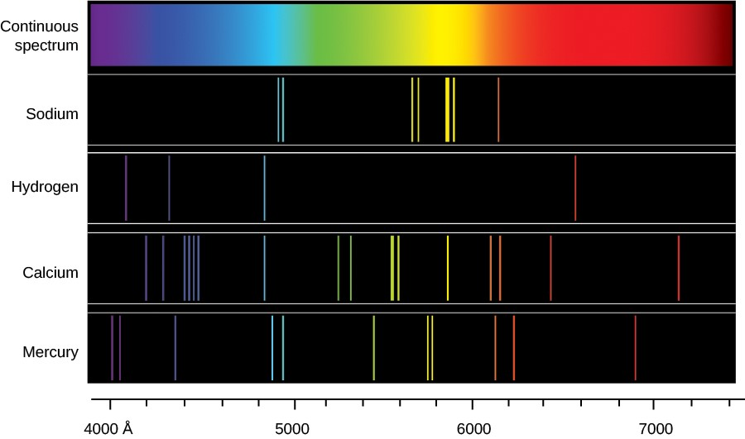
Why, and What is Spectroscopy?

Slide 4
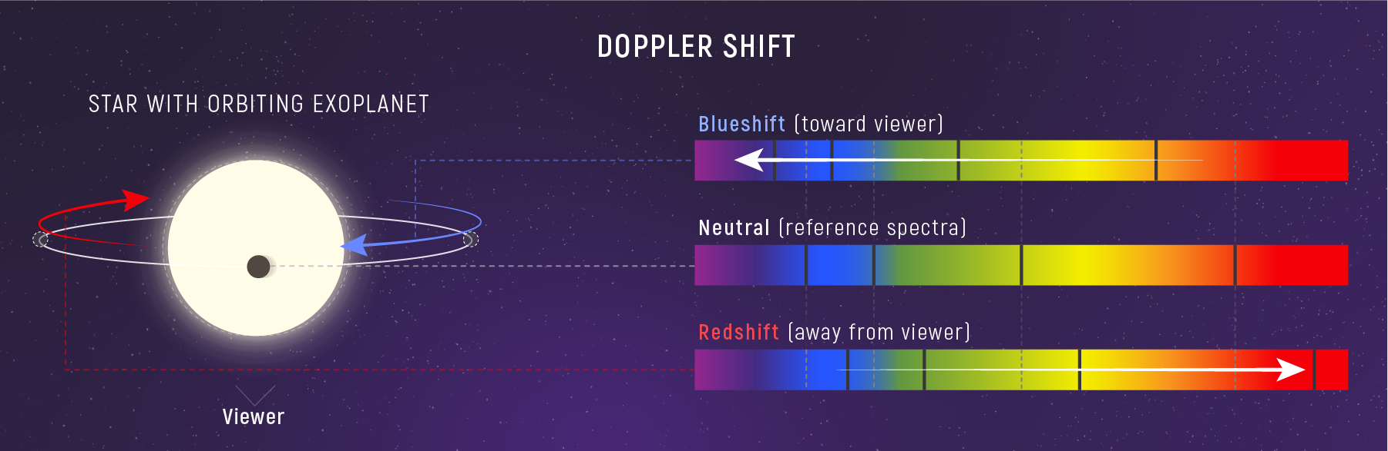
1. How fast an object is moving:
2. What is it made of? (Chemical composition)
3. Temperature and density
4. How old is the object? What history did it go through?
Which ultimately roots back to the formation of galaxies and stars!

Slide 5
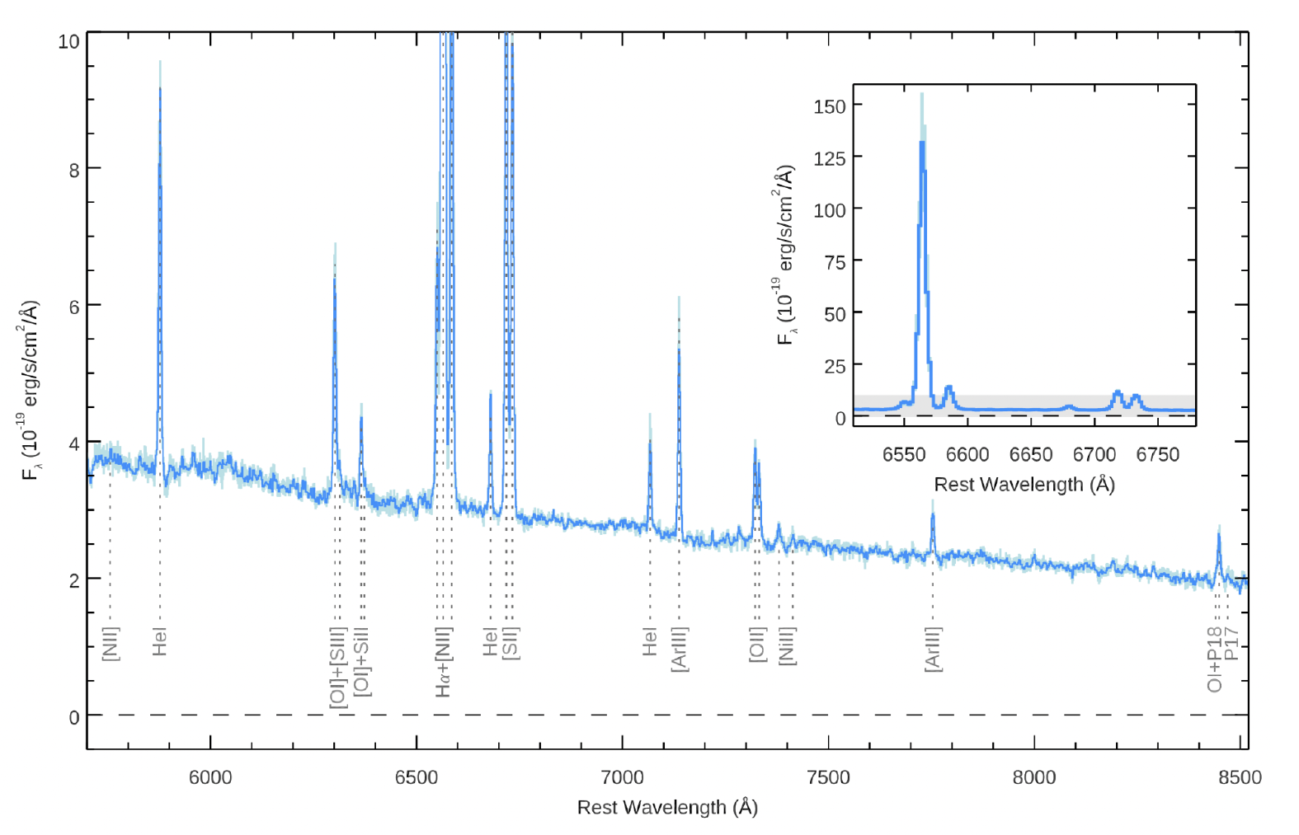
As developed as space technologies have become, they still have their limitations.
?s
?
A composite spectrum produced by the CECILIA survey (Reisner Honors Thesis, Storm et al. 2023.)

Slide 6
This is where we use fancy statistical analysis!
Data in between discrete data points
Interpolation!
Data beyond the scope of our data set
Statistical modeling (MCMC)

Slide 7
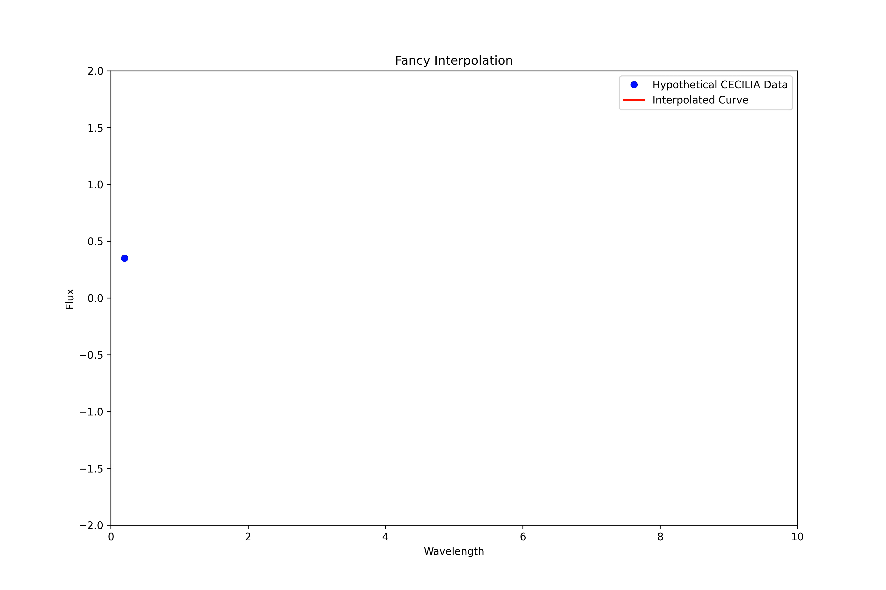

Slide 8
Reasons we need a reliable modeling tool:
Improving validity of predictions and mapping of celestial objects
Improve validity of proposals
Improve understanding of trends and behaviors
Improve understanding of history and future
Fill in the empty gaps and answer big question marks
Develop theories, that could ultimately turn into laws.
Improve understanding of relationships between variables
etc.. ~these branches could have infinite lengths due to the countless uses of models

Slide 9
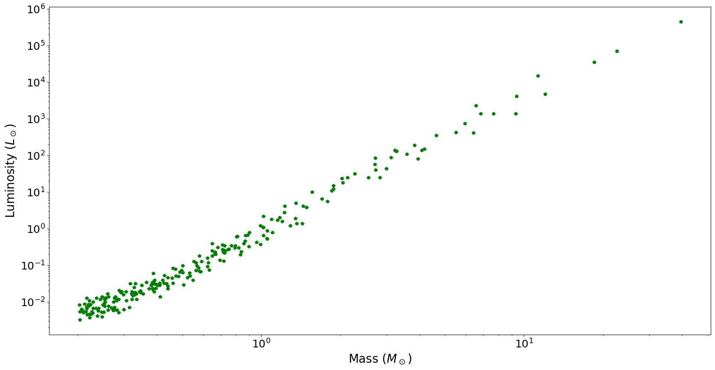

Slide 10
What’s the luminosity at 10 solar masses?

Slide 11
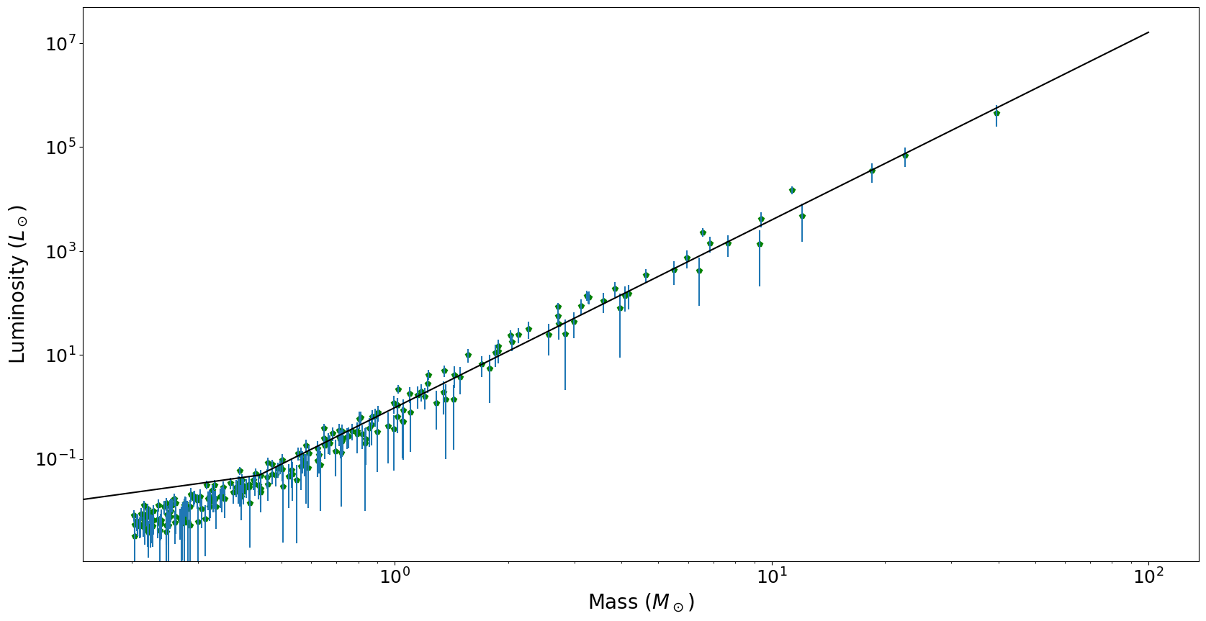
By making a statistical model based on the data we can determine accurate and precise estimates of luminosities!

Slide 12
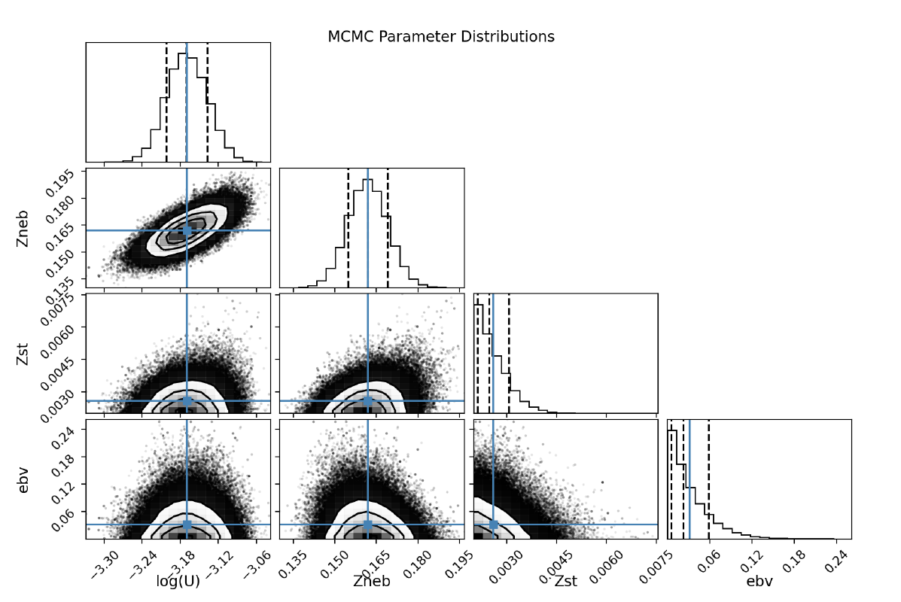
By incorporating statistical modeling and interpolation to data sets from CECILIA, we can get some cool plots like this:
So, what’s going on here?
~ Reisner Thesis 2024

Slide 13
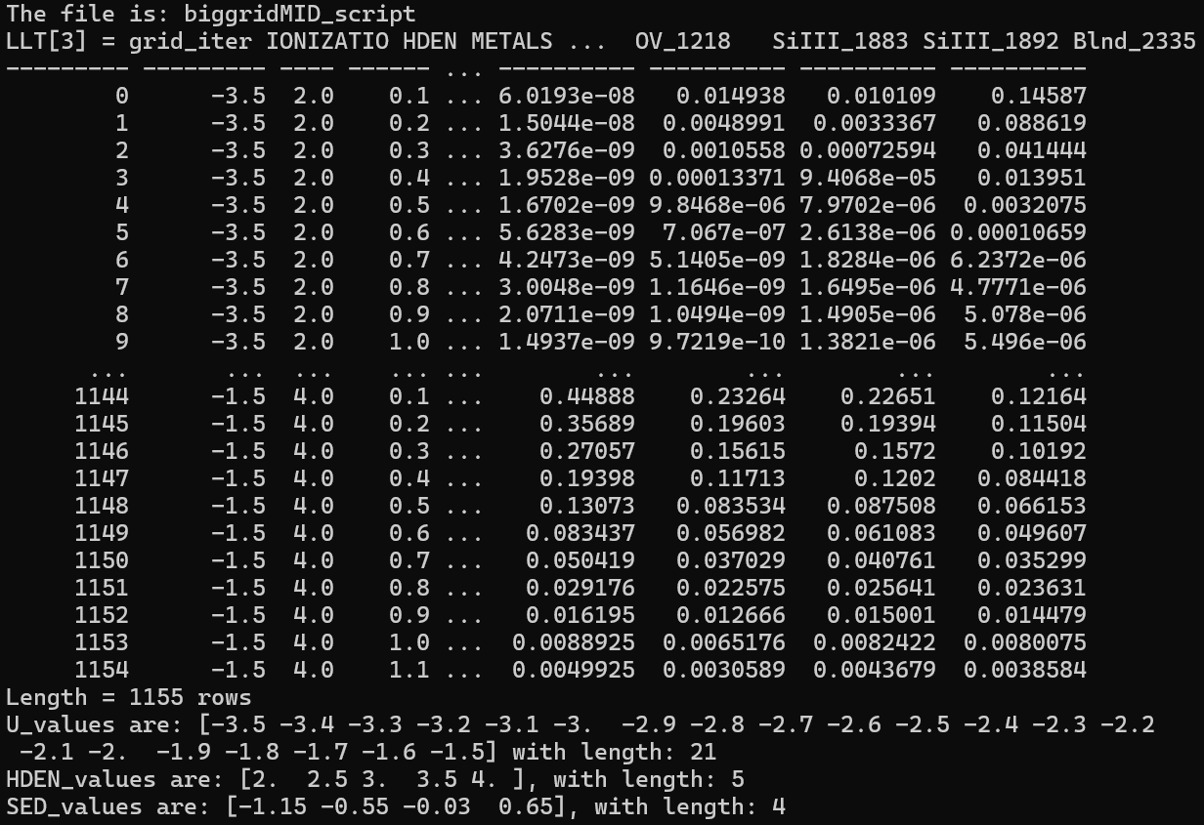
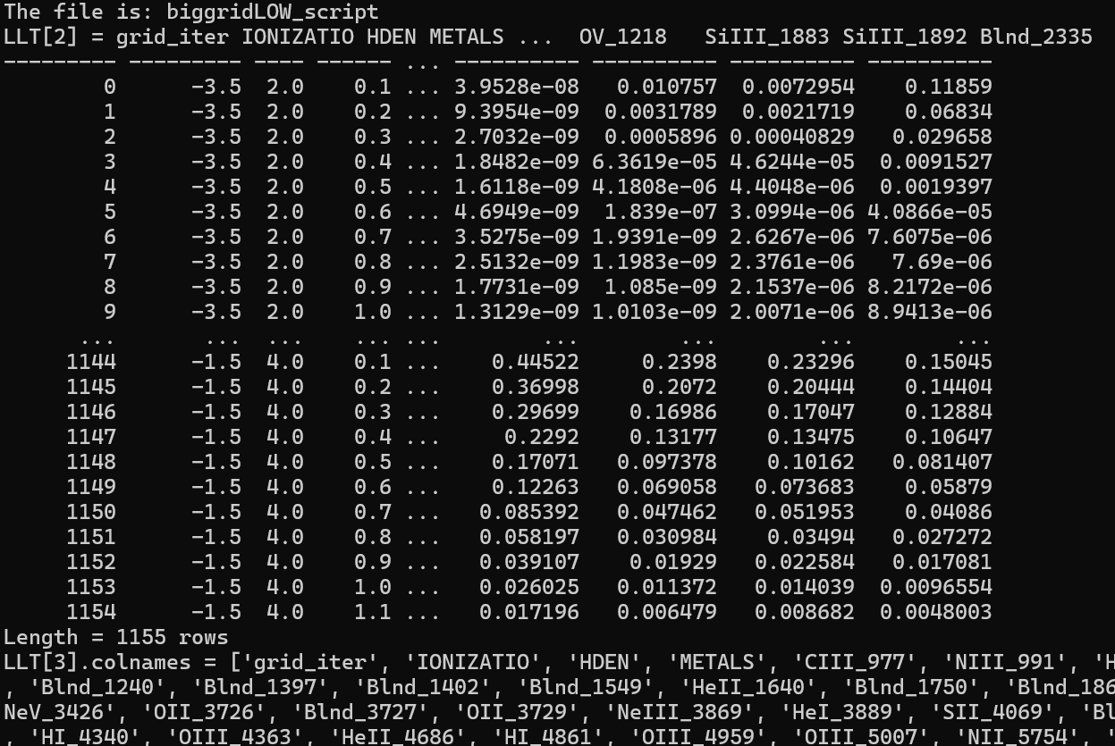
By the aid of a spectral synthesis software designed to model a wide range of interstellar clouds called “cloudy,”
My colleagues were able to acquire massive data sets modeling interstellar nebulae (specifically Mariposa)

Slide 14
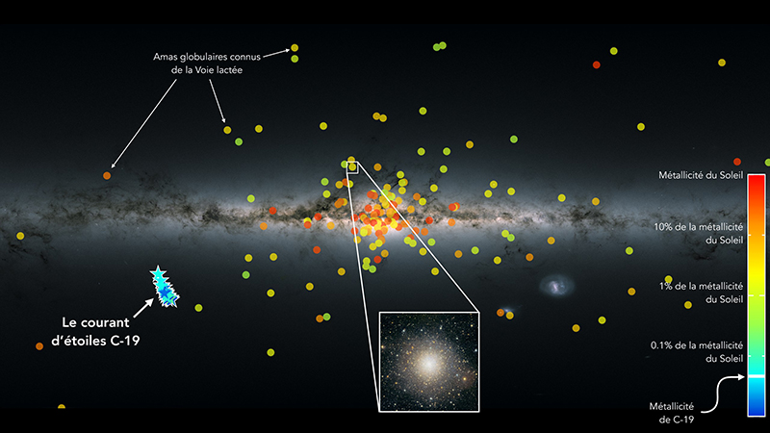
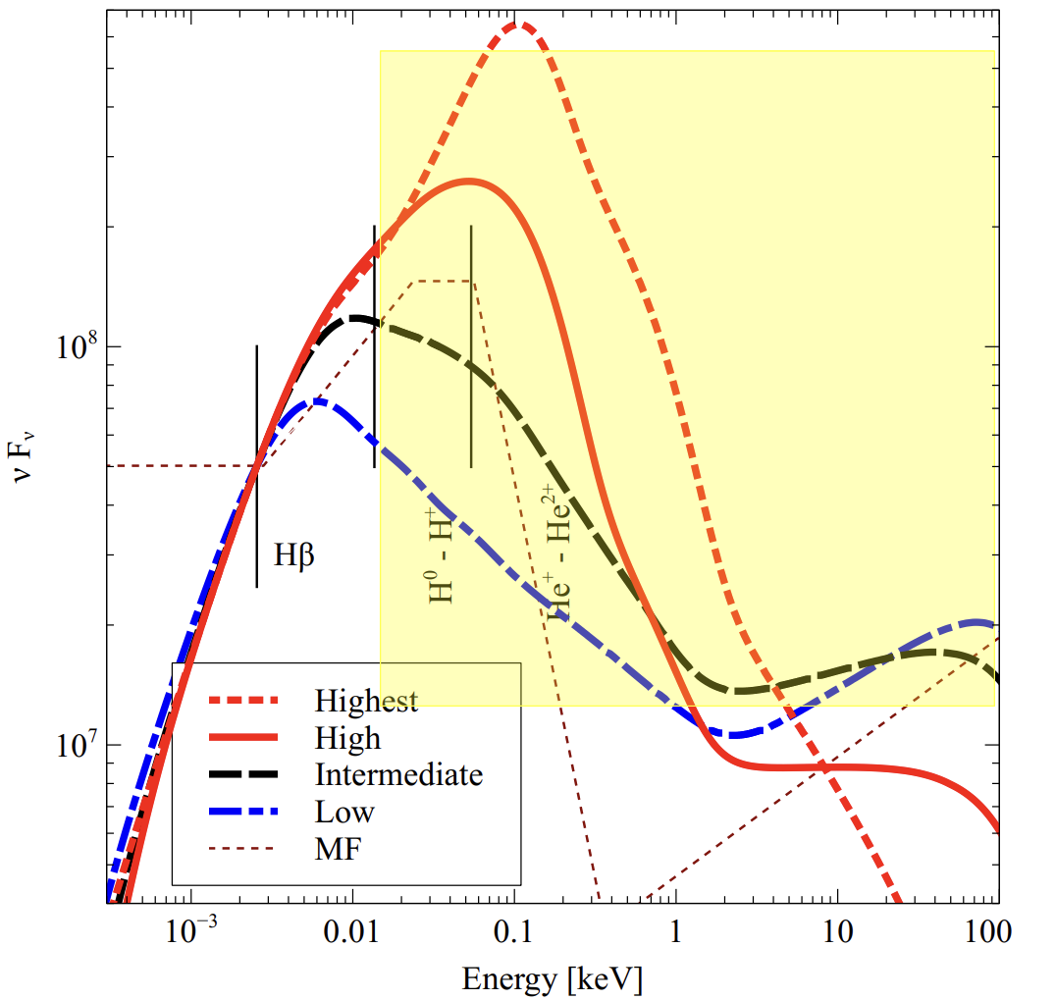
How cloudy works:
In a statistical model, we vary multiple parameters and get response variables back from it so we could study how each parameter changed the response variable
As indicated by the previous slide, cloudy probably did at least 10,000 different variations for the model so we could get an accurate model.
Charles Reisner worked on varying stellar metallicities, the percentage of metals in stars of the cloud.
Ben worked on varying SED (Spectral Energy Distribution), and hydrogen densities.

Slide 15
Why vary SED?

Slide 16
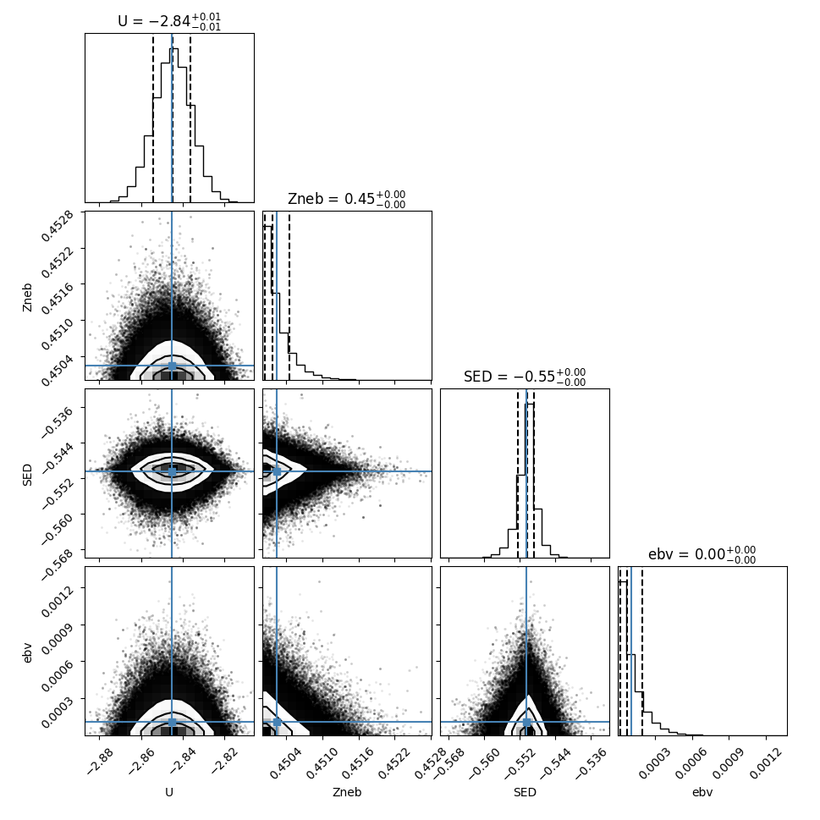
More of Charles’ work, which I continued.
After making the models, we must find some sort of way to test how accurate this model is compared to real data, then either accept or reject the model. This is where CECILIA data play a great role.
By using a Monte Carlo/Markov Chain algorithm, we can determine the validity of such models, which would bring us back to this:

Slide 17
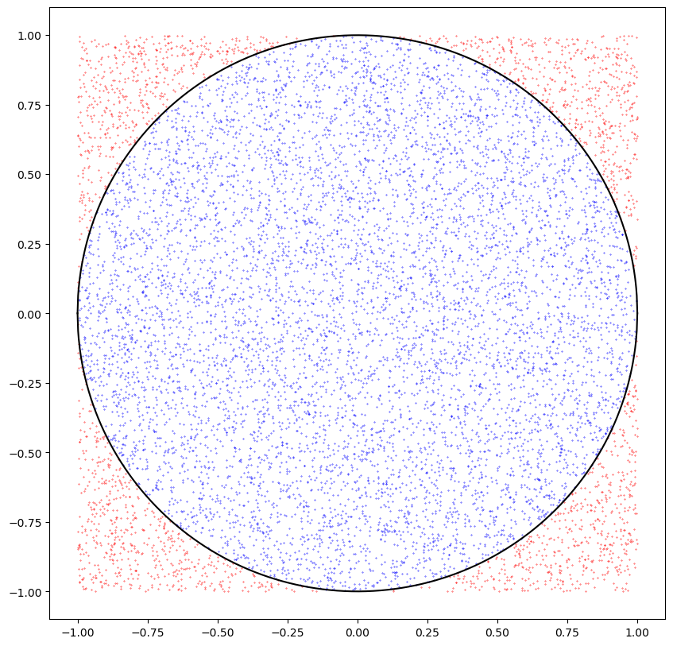
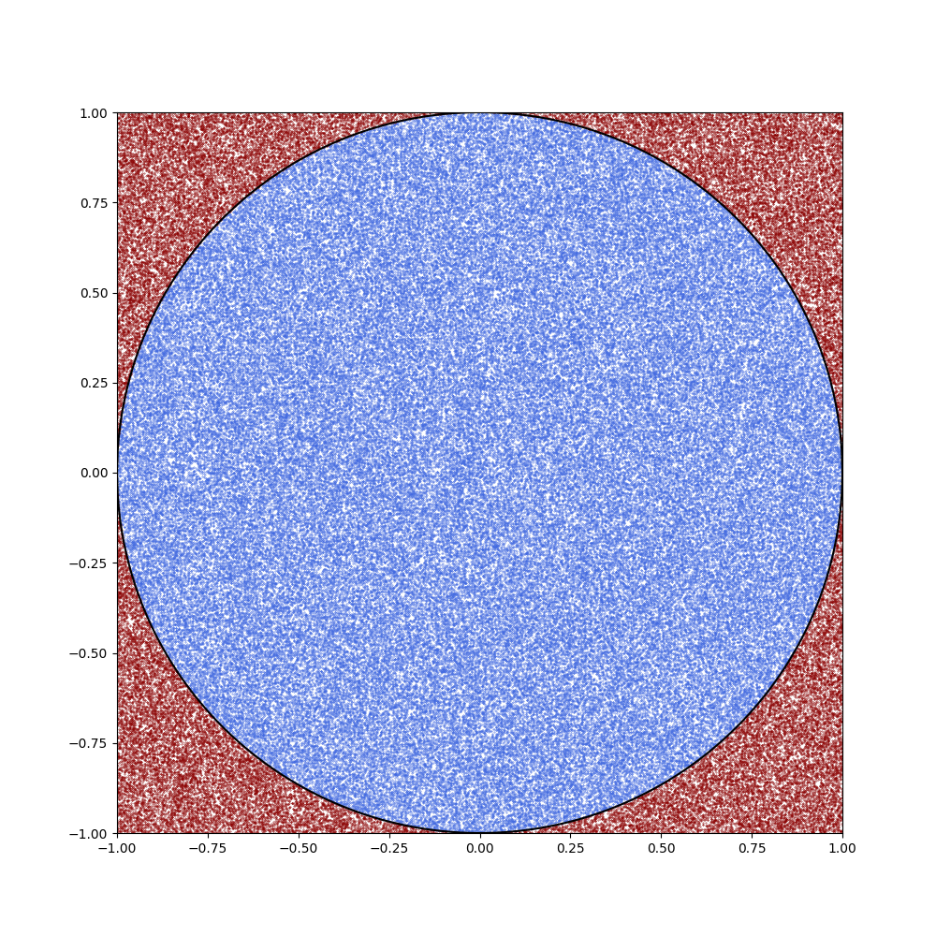
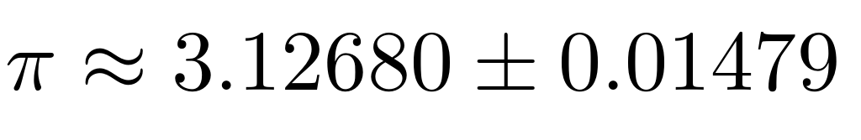
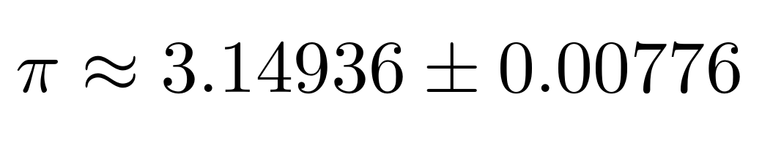
Monte Carlo:
Fun fact: if you throw ten thousand darts on a dart board randomly, count how many you missed and how many you didn’t miss, you can estimate π!! (please don’t try this at home)

Slide 18
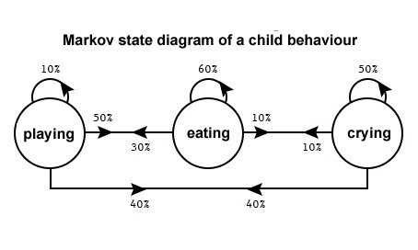
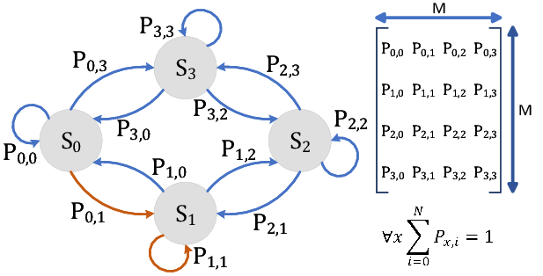
Markov Chains
A Markov chain or Markov process is a stochastic model describing a sequence of possible events in which the probability of each event depends only on the state attained in the previous event. Infoarmally, this may be thought of as, "What happens next depends only on the state of affairs now.“ ~ Wikipedia.
A statistician on Quora names Luis Fok got bored while baby sitting and decided to make this model

Slide 19
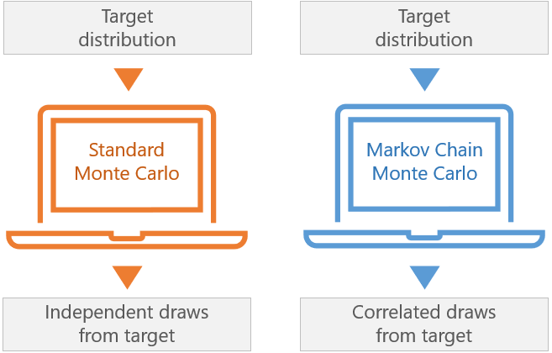
Combining the power of Markov Chains and Monte Carlo makes a statistical model validation algorithm unstoppable! (metaphorically of course, it did stop me numerous times.)

Slide 20
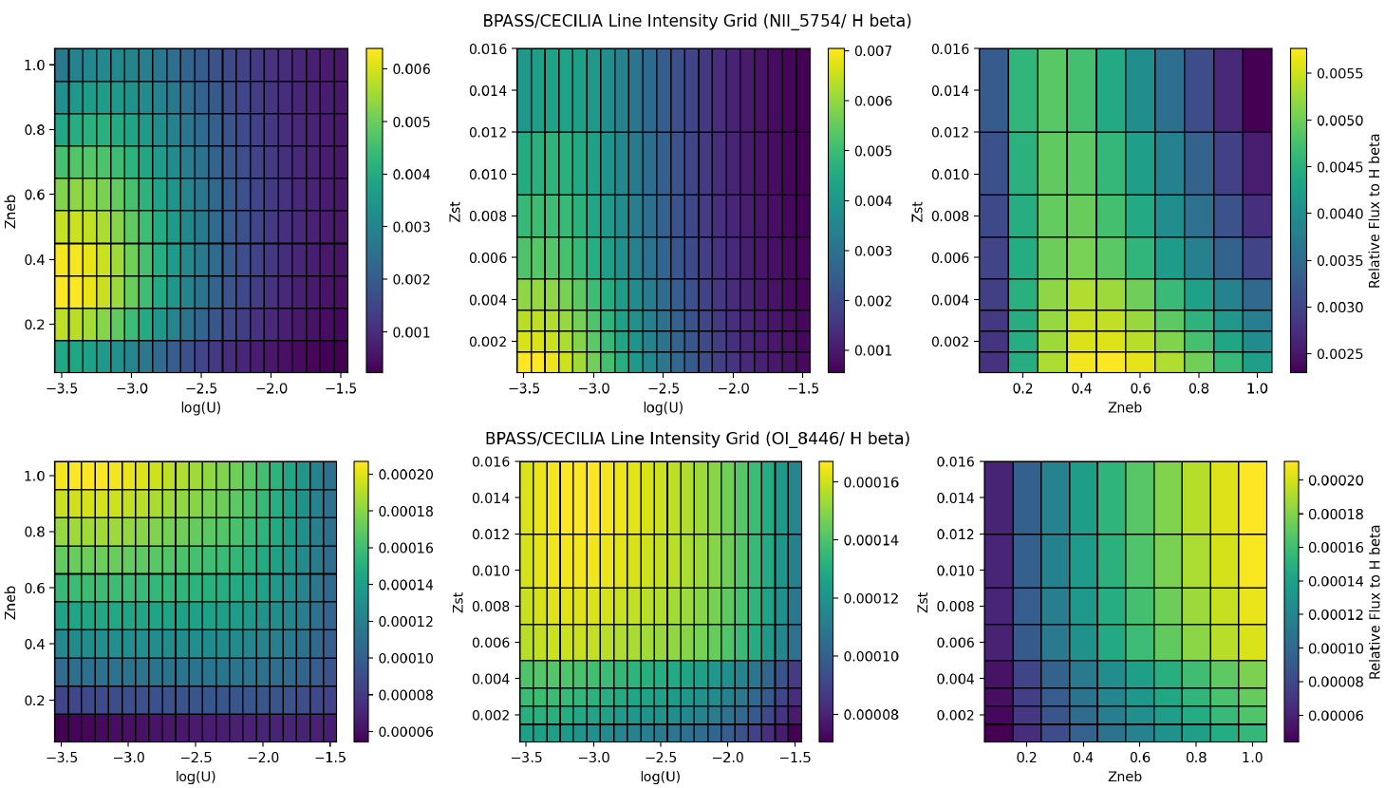
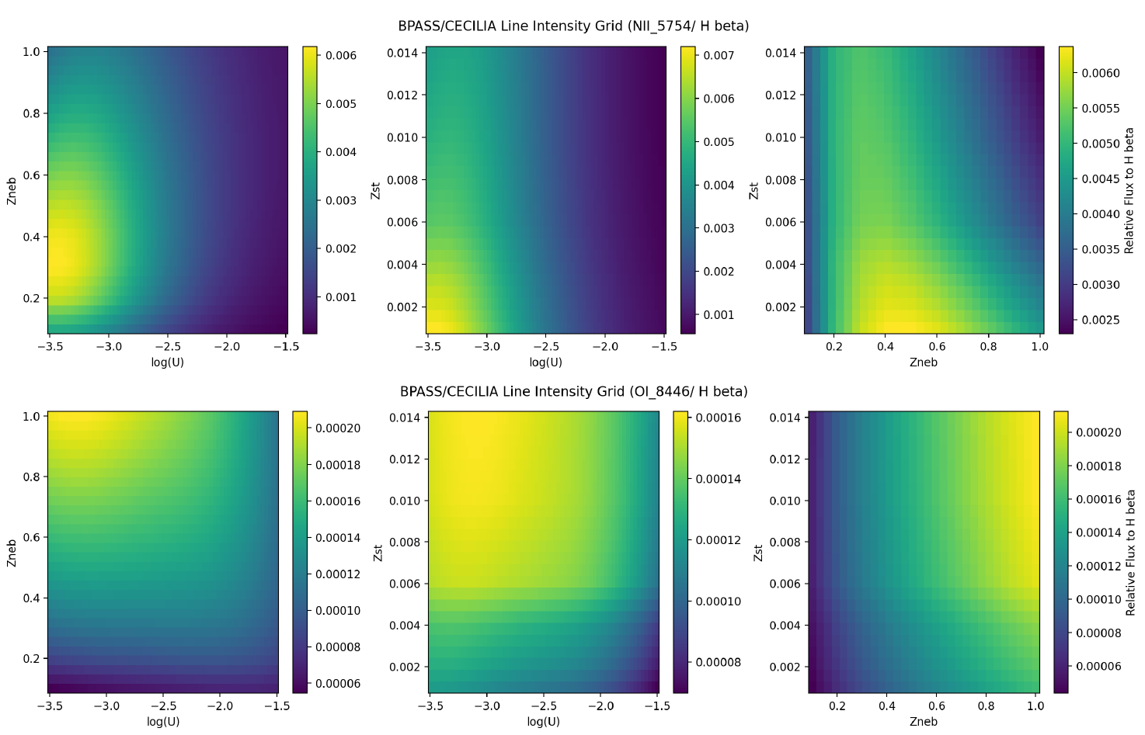
A single MCMC walker utilizes the following to determine the validity of a data set:
Interpolating data points.
Model Function to compare data with. (Posterior Function)
Likelihood function, to determine the validity of the current data point based on its prior data points.
Prior Likelihood function, determines the likelihood of prior data points.
Evidence probability function, provides the estimated validity of one data point.
Make corner plots!
Notes:
The fundamental process of running an MCMC in this mode is to compare generated models against data. Those models are generated by a set of parameters, and our goal is usually to sample from the set of parameters that produces the models that well-fit our data.

Slide 21
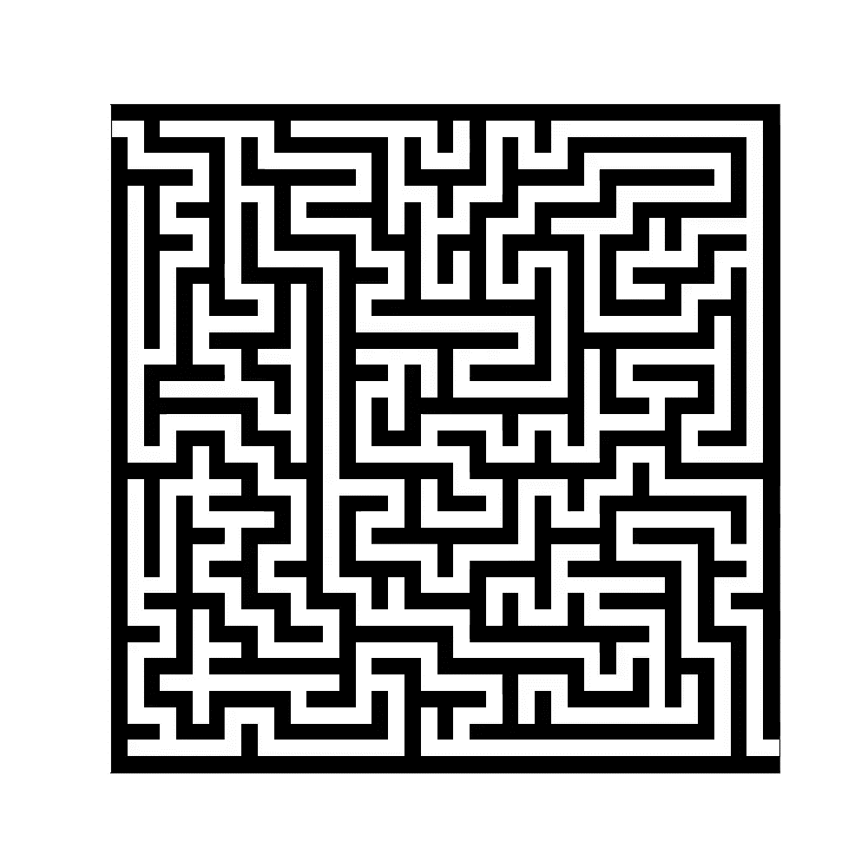
An analogy to the MCMC walkers:

Slide 22
Interpreting the corner plots:
Nebula Metallicity
Star Metallicity
Dust Extinction

Slide 23
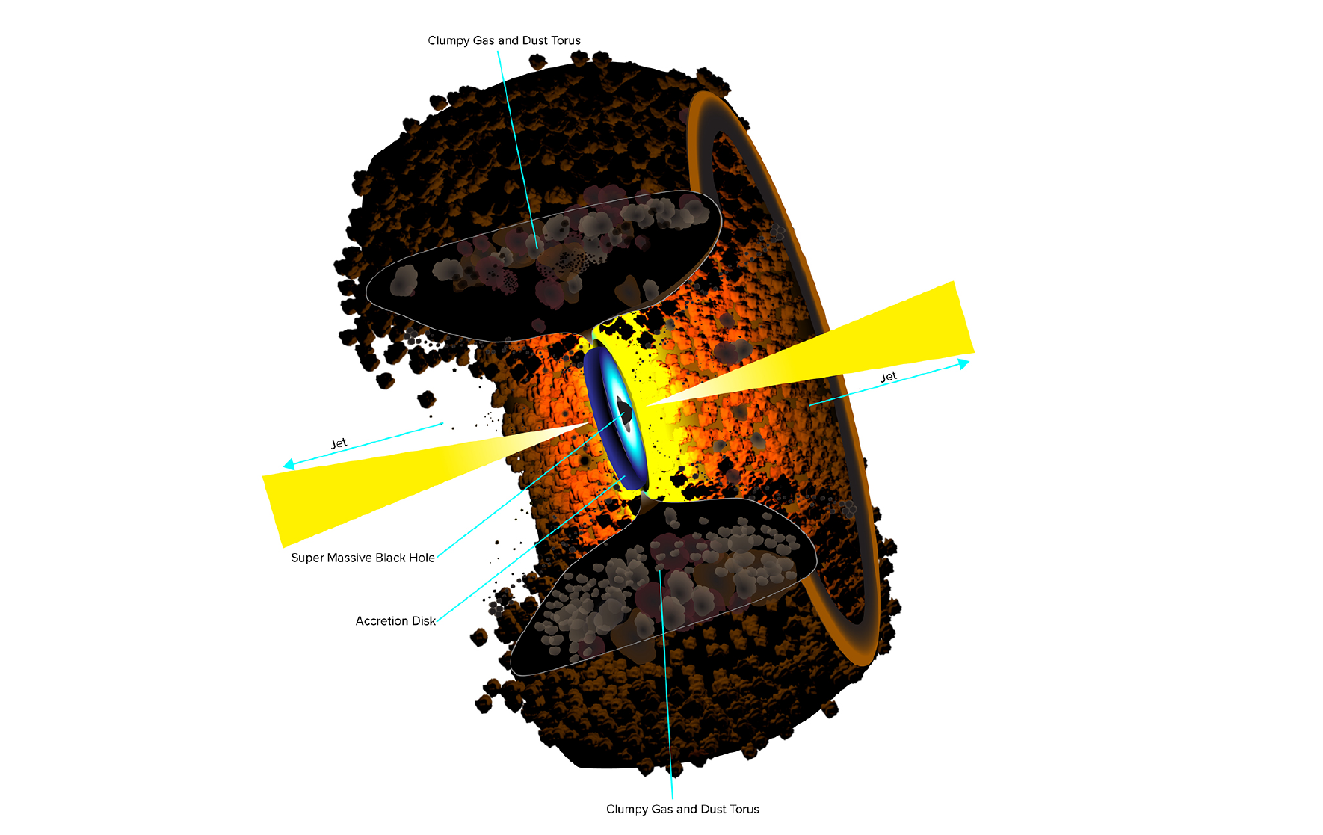

Slide 24
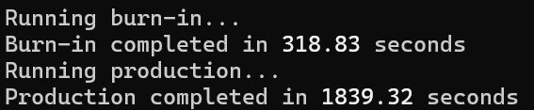
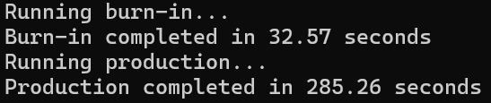
My work:
Significantly improved the program’s computational efficiency, lowering the total computation time from 35 minutes, to 3~6 minutes.
Optimized the program’s capability in being used for other purposes, i.e. the program became more general and accessible for more purposes.
Investigated the variations in SED instead of Zst, future work will talk more about this.

Slide 25
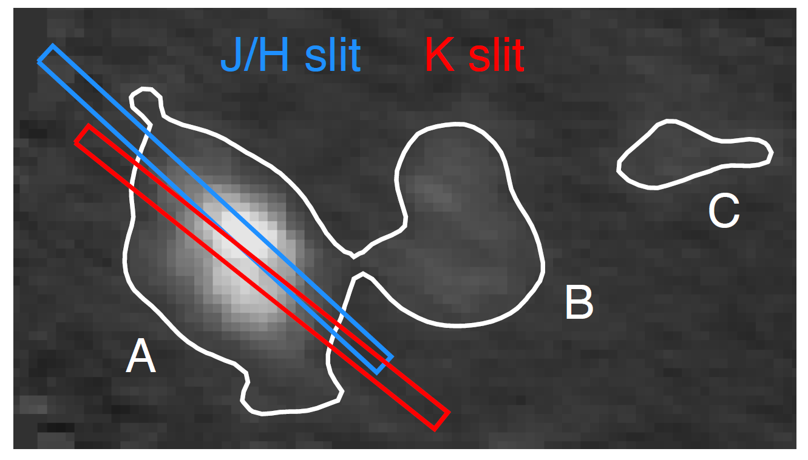
From Delaney’s Presentation (and Becca’s thesis)

Slide 26
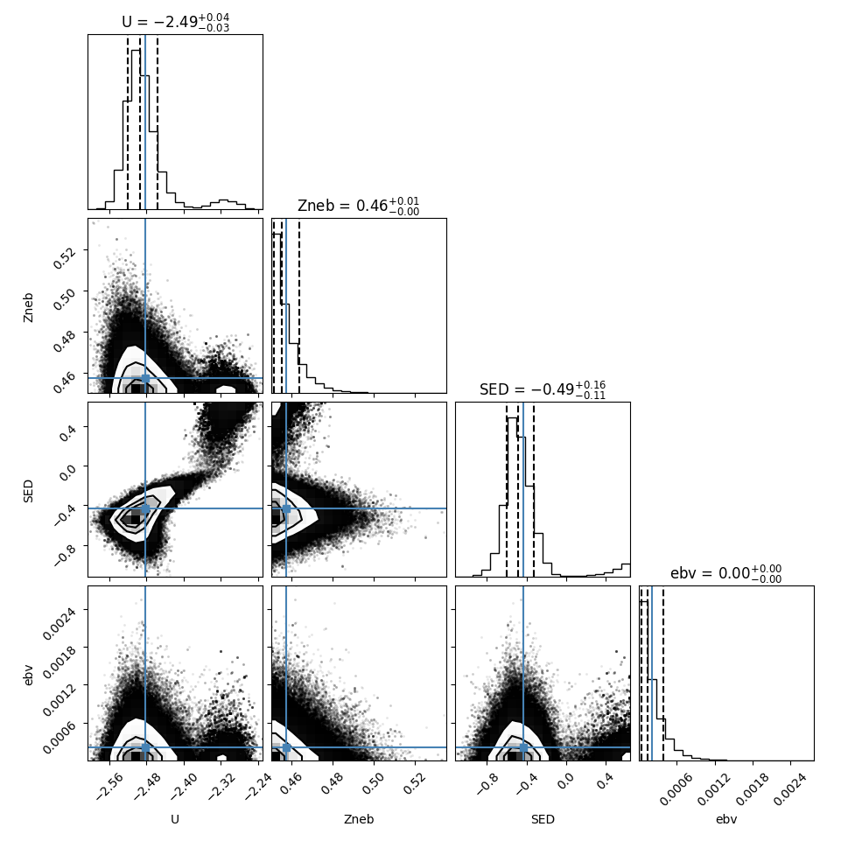
Results!
SED variations with lines measured by only Aperture A.
SED variations with lines measured by Aperture A.

Slide 27
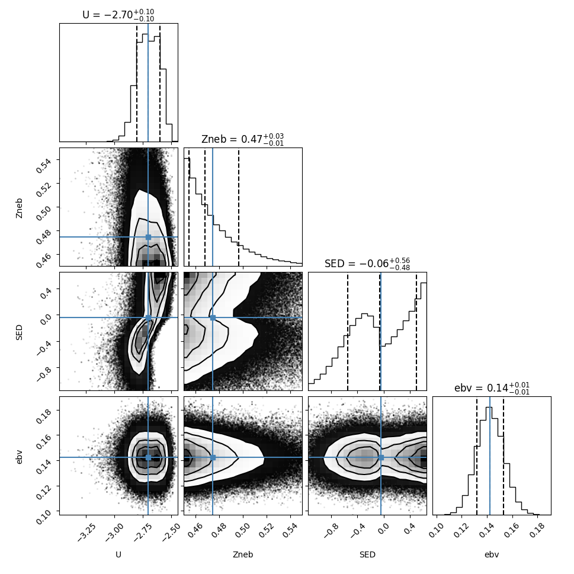
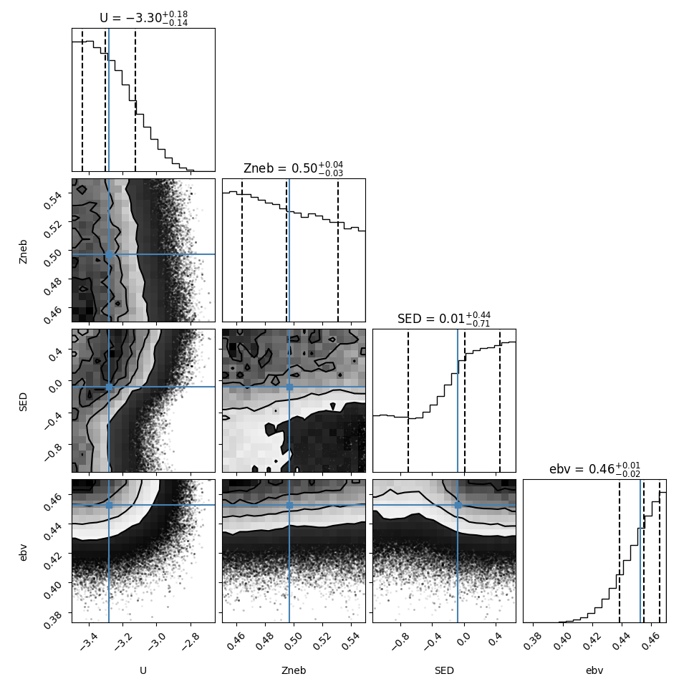
Results!
SED variations with lines measured by Aperture B.
SED variations with lines measured by Aperture C.

Slide 28
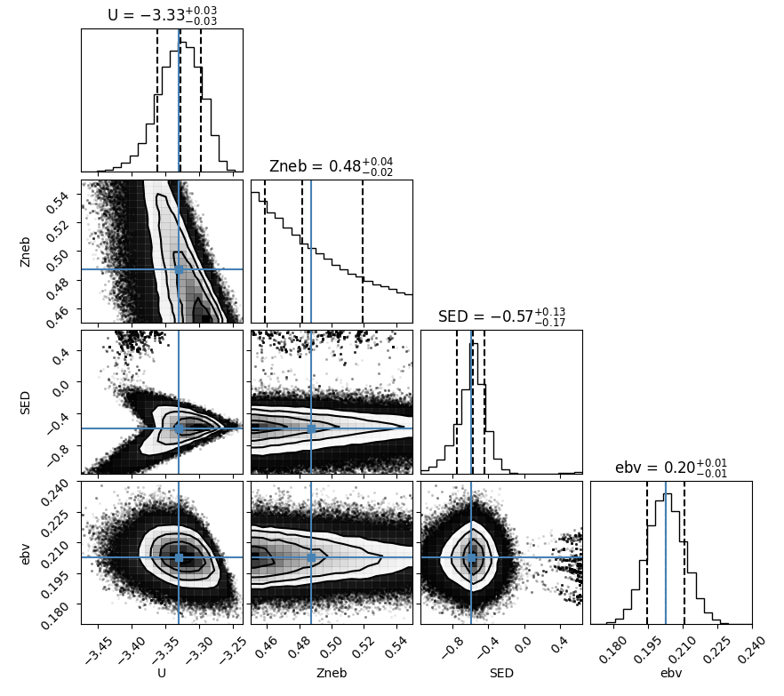
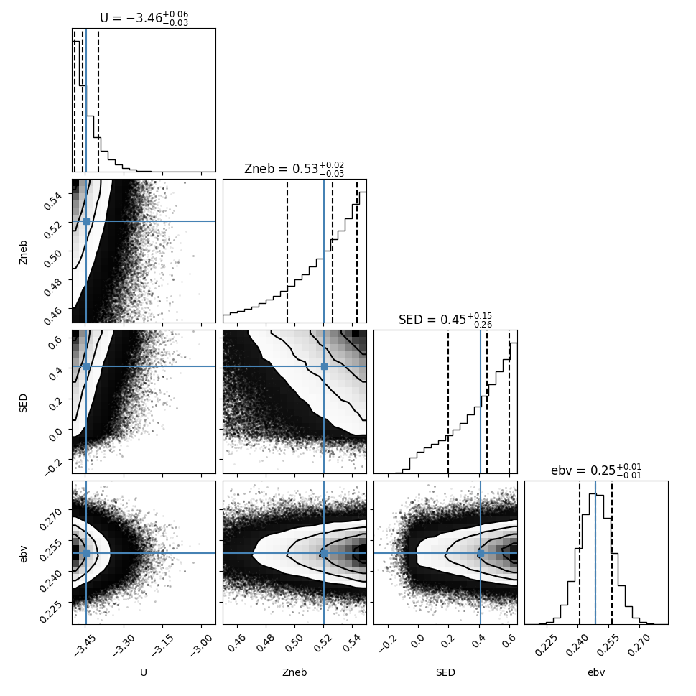
Results!
SED variations with lines measured by JHslit.
SED variations with lines measured by Kslit.

Slide 29
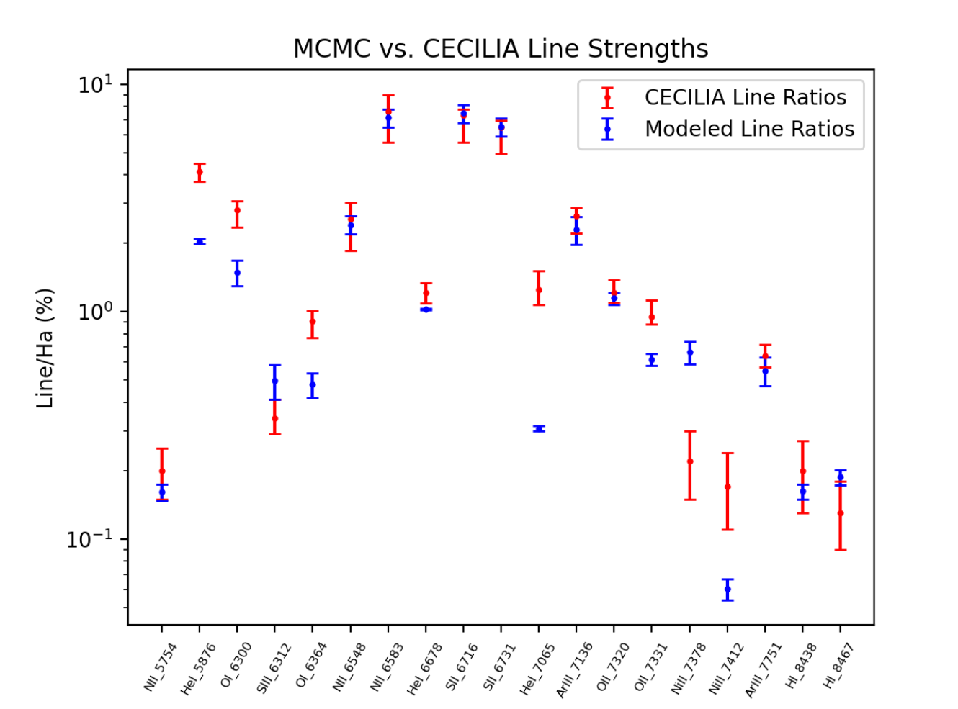
Reisner Thesis, 2024

Slide 30
Future work includes:
Improving data structure in the program for accessibility and future utilities. (AstroPy → Pandas Dataframes)
Improving line ratios and normalization in the MCMC algorithm to avoid dust extinctions.
Varying HDEN alone, varying HDEN with SED, varying HDEN with SED and Zst.
Hopefully publishing the program on GitHub for other astronomers to use!

Slide 31
Questions?
Lots of love and support to Professor Trainor
Youssef El Gharably – Summer Hackman Research 2024
Professor Trainor
NGC1672 – JWST/Hubble

